Slide 1

Assignment: Clustering
Instructor: Dr. Manish Singh
T.A.(s): Rohan Banerjee
Sailaja Rajanala
Konjengbam Anand
06-06-2019 Indian Institute of Technology Hyderabad Computer Science & Engineering

Slide 2
K-Means Clustering
Input: Points x₁,x₂,…x_{n}
Allocate centroids c₁,…c_{k} at random locations
Until convergence:
For each point x_{i}:
Find nearest centroid c_{j}
Assign the point x_{i} to c_{j}
For each cluster j=1…k:
Mean of all points x_{i} assigned to cluster j in prior step
Stop until no points change clusters
Time Complexity: O(t*k*n)

Slide 3
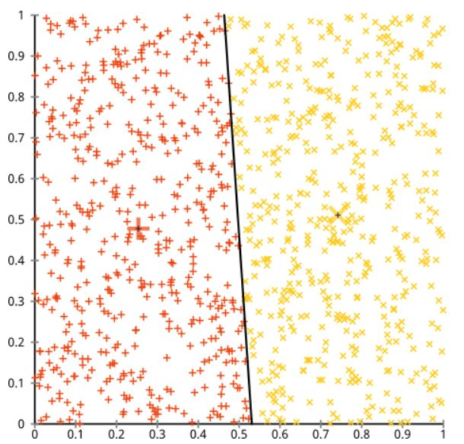
K-Means Clustering
Drawbacks:
Initialization sensitivity
Always produces clusters (even on uniform data)
Sensitive to scale
Dataset must be rescaled
One dimension can dominate the result
Can get stuck in a local minimum

Slide 4
K-Means++
Smart Initialization:
Pick a random point as centroid
For each data point x, compute D(x), the distance between x and the nearest center chosen
Use a weighted probability distribution where a point x is chosen with probability proportional to D(x)²
Repeat above two steps for k centers
Proceed with k-means

Slide 5
DBSCAN Clustering
Cluster of arbitrary shapes can be detected
Can handle noise
Only one scan through the dataset
Core Point: More than minpts within eps
Border Point: Less than minpts but in neighborhood of a core point
Noise Point: Neither a core nor a border point
O(n²) time complexity

Slide 6
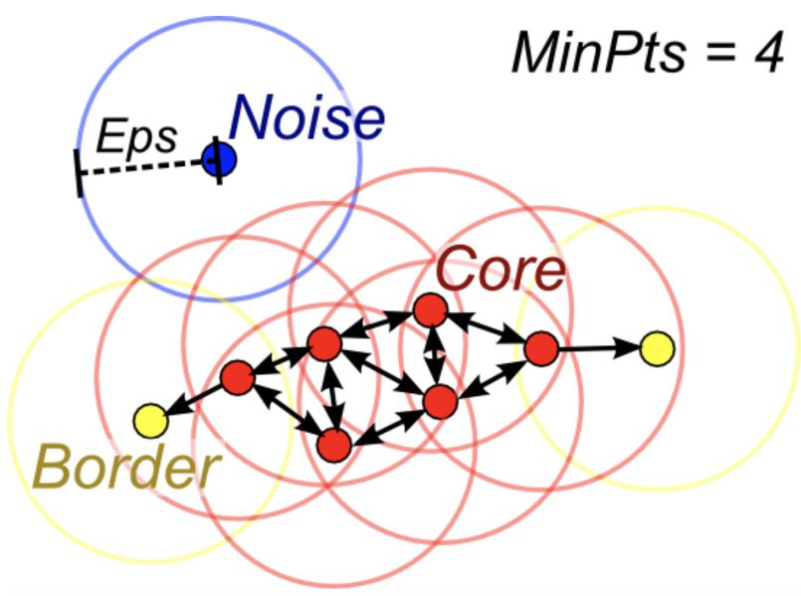
DBSCAN Clustering
Drawbacks:
Choosing eps and minpts can be difficult
Doesn’t work well with clusters of varying densities
Doesn’t work well with high dimensional data

Slide 7
Agglomerative Clustering
Nearby points in same clusters
Collection of n singleton clusters
Each cluster has only one datapoint
Repeat till one cluster remains
Find closest cluster pairs D(c_{i}, c_{j})
Merge the clusters c_{i} and c_{j} into one cluster
Any number of clusters can be chosen from the obtained dendogram

Slide 8
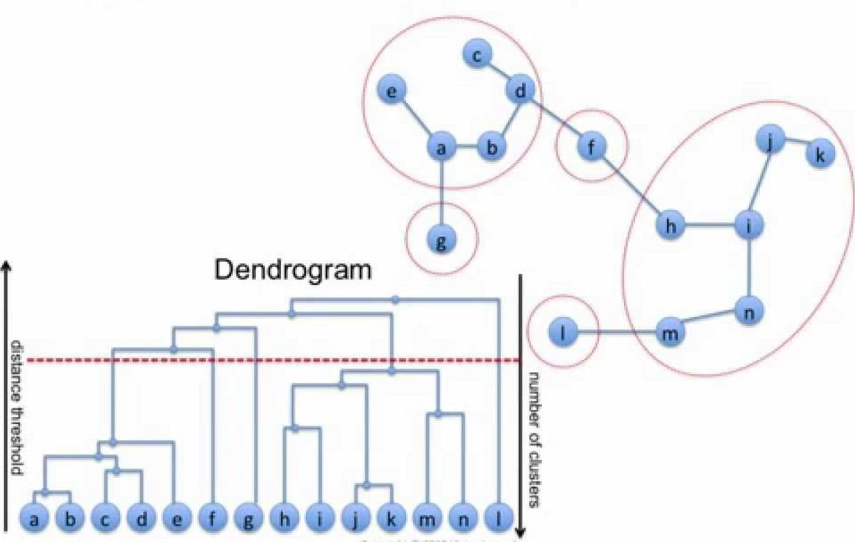
Agglomerative Clustering

Slide 9
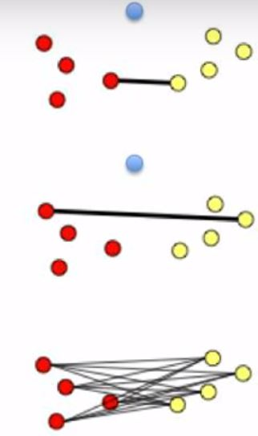
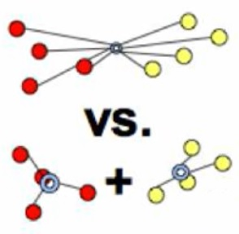
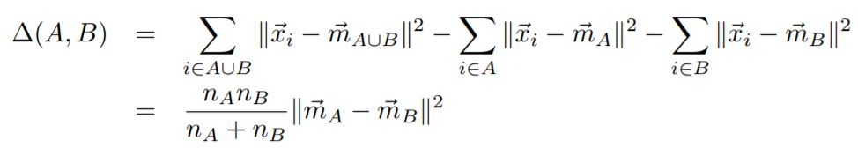
Agglomerative Clustering
Single:
D(c_{1,} c₂) = min D(x₁, x₂)
Nearest neighbor
Produces very long chains
Complete:
Farthest elements
D(c₁, c₂) = max D(x₁, x₂)
Average:
Mean of all pairwise distances between clusters
Ward:
Merge two clusters that results in least increase in variance given by,

Slide 10
Spectral Clustering
No assumptions on cluster shapes
Iterative process not required
Steps:
Construct a similarity graph (KNN graph)
Embed datapoints using spectral embedding (using Eigen vectors)
Use classical algorithms like k-means

Slide 11
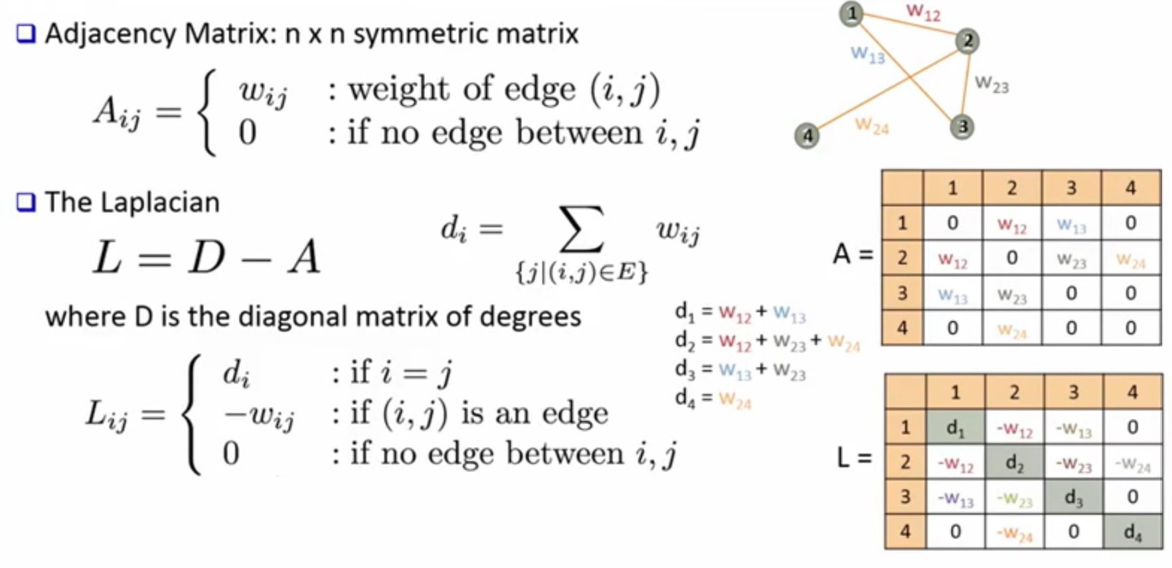
Spectral Clustering

Slide 12
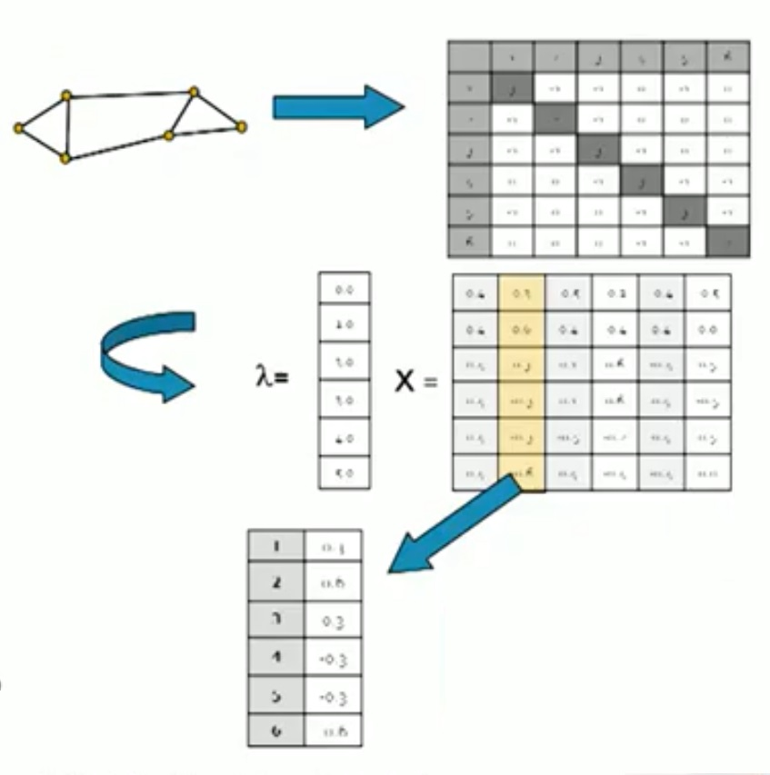
Spectral Clustering
Find Eigen values and corresponding vectors using the Laplacian matrix, L
Finally use k-means to identify the k-clusters

Slide 13
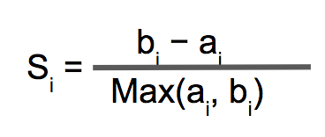
Silhouette Coefficient
Unsupervised evaluation approach
a_{i} = Average distance between the record and all the other records in the same cluster
b_{i} = Lowest of average distances between the point and all the points in other clusters
Silhouette coefficient for a point is given as,

